Slide 1
Lecture 7:
ResNet
Pooya Mohammadi Lecture 7 - 1 Winter-2020

Slide 2
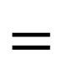

Last time: Edge Detection(Convolving)
3 | 0 | 1 | 2 | 7 | 4
1 | 5 | 8 | 9 | 3 | 1
2 | 7 | 2 | 5 | 1 | 3
0 | 1 | 3 | 1 | 7 | 8
4 | 2 | 1 | 6 | 2 | 8
2 | 4 | 5 | 2 | 3 | 9
1
0
-1
1
0
-1
1
0
-1
1
0
-1
-5 | -4 | 0 | 8
-10 | -2 | 2 | 3
0 | -2 | 4 | -7
-3 | -2 | -3 | -16
1 | 0 | -1
1 | 0 | -1
1 | 0 | -1
1
0
-1
1
0
-1
$$∗$$
$$=$$
Pooya Mohammadi Lecture 7 - 2 Winter-2020

Slide 3

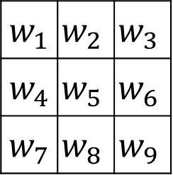
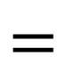
Last time: Learning how to detect edges
1 | 0 | -1
1 | 0 | -1
1 | 0 | -1
1 | 0 | -1
2 | 0 | -2
1 | 0 | -1
3 | 0 | -3
10 | 0 | -10
3 | 0 | -3
Sobel
Scharr
3 | 0 | 1 | 2 | 7 | 4
1 | 5 | 8 | 9 | 3 | 1
2 | 7 | 2 | 5 | 1 | 3
0 | 1 | 3 | 1 | 7 | 8
4 | 2 | 1 | 6 | 2 | 8
2 | 4 | 5 | 2 | 3 | 9
$w_{1}$ | $$w_{2}$$ | $$w_{3}$$
$w_{4}$ | $$w_{5}$$ | $$w_{6}$$
$w_{7}$ | $$w_{8}$$ | $$w_{9}$$
$$∗$$
$$=$$
Pooya Mohammadi Lecture 7 - 3 Winter-2020

Slide 4
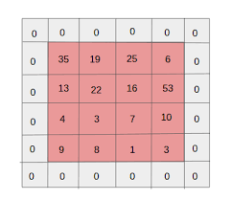
Last time: Padding
Problems:
Shrink output
Throw away information
Pooya Mohammadi Lecture 7 - 4 Winter-2020

Slide 5
Last time: Padding( Valid and Same )
“Valid”: No padding
“Same”:
Pad so that output size is the same as the input size.
Pooya Mohammadi Lecture 7 - 5 Winter-2020

Slide 6
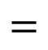

Last time: Stride
2 | 3 | 7 | 4 | 6 | 2 | 9
6 | 6 | 9 | 8 | 7 | 4 | 3
3 | 4 | 8 | 3 | 8 | 9 | 7
7 | 8 | 3 | 6 | 6 | 3 | 4
4 | 2 | 1 | 8 | 3 | 4 | 6
3 | 2 | 4 | 1 | 9 | 8 | 3
0 | 1 | 3 | 9 | 2 | 1 | 4
3
4
4
3
4
4
1
0
2
1
0
2
-1
0
3
3 | 4 | 4
1 | 0 | 2
-1 | 0 | 3
91 | 100 | 83
69 | 91 | 127
44 | 72 | 74
-1
0
3
$$∗$$
$$=$$
Pooya Mohammadi Lecture 7 - 6 Winter-2020

Slide 7
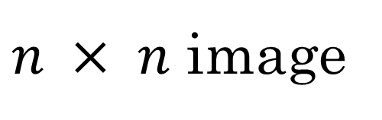
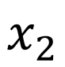
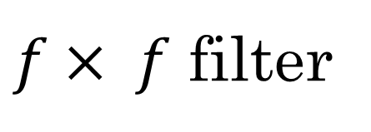
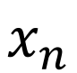
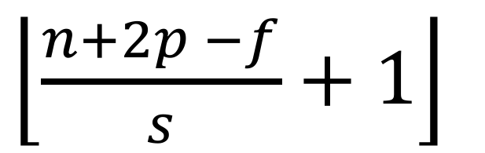
Last time: Formula
$n × n$ image
$f× f$ filter
padding p
stride s
$\left\lfloor \frac{n+2p −f}{s}+1\right\rfloor$
$\left\lfloor \frac{n+2p −f}{s}+1\right\rfloor$
$$×$$
Pooya Mohammadi Lecture 7 - 7 Winter-2020

Slide 8


Last time: Convolutions over Volume (RGB image)
$$∗$$
$$=$$
3 x 3 x 3
4 x 4
6 x 6 x 3
Pooya Mohammadi Lecture 7 - 8 Winter-2020

Slide 9




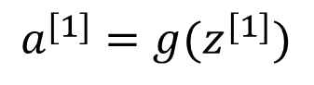
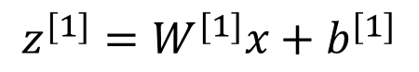
Last time: Multiple Filters
$$∗$$
$$=$$
3 x 3 x 3
4 x 4
4 x 4
$$∗$$
$$=$$
6 x 6 x 3
3 x 3 x 3
4 x 4
4 x 4
$$z^{[1]}=W^{[1]}x+b^{[1]}$$
4 x 4 x 2
$$a^{[1]}=g(z^{[1]})$$
Pooya Mohammadi Lecture 7 - 9 Winter-2020

Slide 10
Last time: MaxPooling
1 | 3 | 2 | 1
2 | 9 | 1 | 1
1 | 3 | 2 | 3
5 | 6 | 1 | 2
Hyper-parameters:
stride = 2
filter = 2
Note:
Max Pooling is done independently on each of the channels
Pooya Mohammadi Lecture 7 - 10 Winter-2020

Slide 11
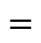

Last time: Why Convolutions
10 | 10 | 10 | 0 | 0 | 0
10 | 10 | 10 | 0 | 0 | 0
10 | 10 | 10 | 0 | 0 | 0
10 | 10 | 10 | 0 | 0 | 0
10 | 10 | 10 | 0 | 0 | 0
10 | 10 | 10 | 0 | 0 | 0
0 | 30 | 30 | 0
0 | 30 | 30 | 0
0 | 30 | 30 | 0
0 | 30 | 30 | 0
1 | 0 | -1
1 | 0 | -1
1 | 0 | -1
$$∗$$
$$=$$
Parameter sharing: A feature detector (such as a vertical edge detector) that’s useful in one part of the image is probably useful in another part of the image
Sparsity of connections: In each layer, each output value depends only on a small number of inputs
Pooya Mohammadi Lecture 7 - 11 Winter-2020

Slide 12
Last time: Why Convolutions
FC layer has no assumptions about input image
CNN assumes there is a local connection in input data
CNN is shift invariant
CNN has a lot few parameters
CNN Needs less training examples
CNN is less prone to over-fitting
Pooya Mohammadi Lecture 7 - 12 Winter-2020

Slide 13
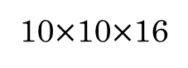
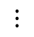
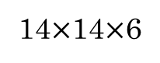
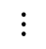
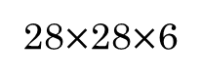
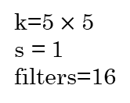
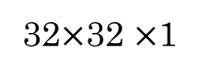
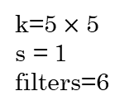
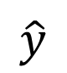
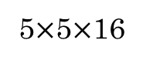
Last time: LeNet-5
avg pool
avg pool
$$\hat{y}$$
k=5$×$ 5
s = 1
filters=6
f = 2
s = 2
k=5$×$ 5
s = 1
filters=16
f = 2
s = 2
$$⋮$$
$$⋮$$
32$×$32 $×$1
28$×$28$×$6
14$×$14$×$6
10$×$10$×$16
5$×$5$×$16
120
84
[LeCun et al., 1998. Gradient-based learning applied to document recognition]
Pooya Mohammadi Lecture 7 - 13 Winter-2020

Slide 14
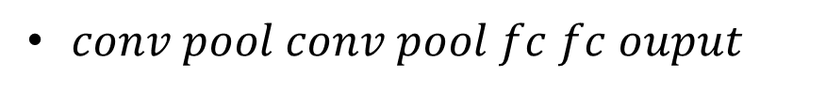
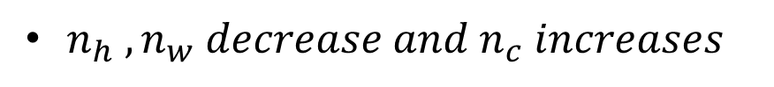
Last time: LeNet-5
Notes:
No padding
Small Network >>> 60k parameters
No ReLU
$n_{h} ,n_{w} decrease and n_{c} increases$
Avg pool
$conv pool conv pool fc fc ouput$
[LeCun et al., 1998. Gradient-based learning applied to document recognition]
Pooya Mohammadi Lecture 7 - 14 Winter-2020

Slide 15
Today:
Preprocessing
Weight Initialization
Batch Normalization
Hyper-Parameter Tuning
ResNet
Pooya Mohammadi Lecture 7 - 15 Winter-2020

Slide 16
Preprocessing
Pooya Mohammadi Lecture 7 - 16 Winter-2020

Slide 17
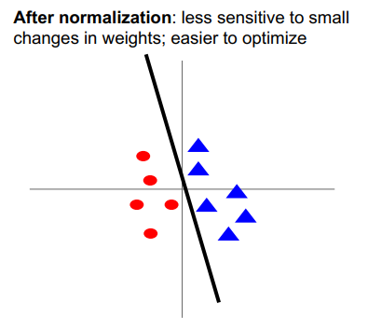
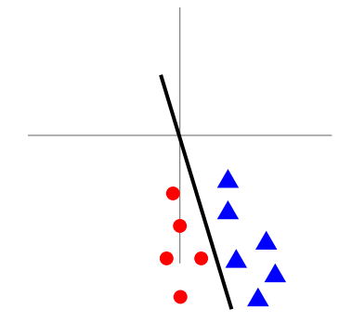
Preprocessing:
Before normalization: classification loss is very sensitive to changes in weight matrix; hard to optimize
After normalization: Less sensitive to small changes in weights; easier to optimize
Pooya Mohammadi Lecture 7 - 17 Winter-2020

Slide 18
Processing:
In practice for Images: center only
e.g. consider CIFAR-10 example with [32,32,3] images
- Subtract the mean image (e.g. AlexNet) (mean image = [32,32,3] array)
- Subtract per-channel mean (e.g. VGGNet) (mean along each channel = 3 numbers)
Not common to normalize
variance, to do PCA or
whitening
Pooya Mohammadi Lecture 7 - 18 Winter-2020

Slide 19
Weight Initialization
Pooya Mohammadi Lecture 7 - 19 Winter-2020

Slide 20
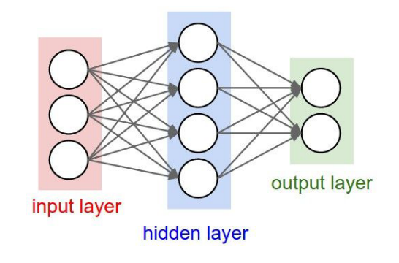
Weight Initialization:
Q: What happens when W=constant init is used?
Pooya Mohammadi Lecture 7 - 20 Winter-2020

Slide 21
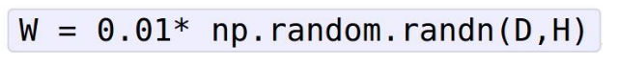
Weight Initialization:
-First idea: Small random numbers
(gaussian with zero-mean and 1e-2 standard deviation)
Works ~okay with small networks, but problems with deeper networks.
Pooya Mohammadi Lecture 7 - 21 Winter-2020

Slide 22
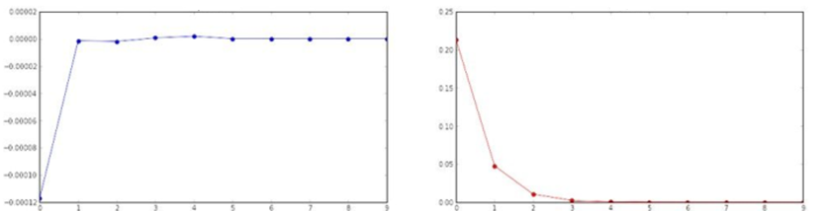
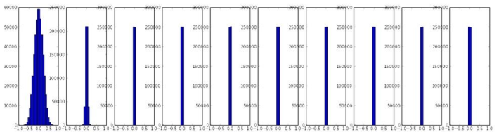
Weight Initialization:
All activations become zero!
Activation is tanh
Layer mean
Layer std
Q: think about the backward pass. What do the gradients look like?
Hint: think about the backward pass for a W*X gate.
Pooya Mohammadi Lecture 7 - 22 Winter-2020

Slide 23
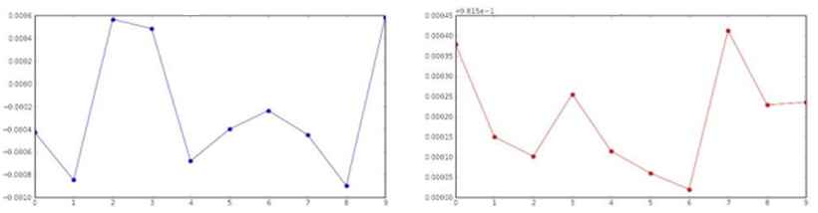
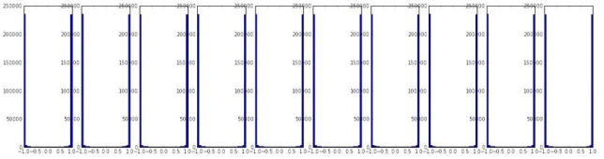
Weight Initialization:
Almost all neurons completely saturated, either -1 and 1. Gradients will be all zero.
Layer mean
Layer std
Pooya Mohammadi Lecture 7 - 23 Winter-2020

Slide 24
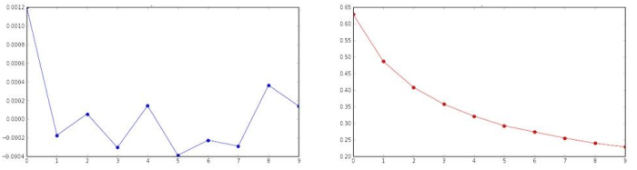
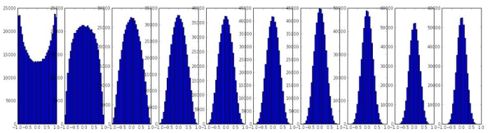
Weight Initialization:
Layer mean
Layer std
Reasonable initialization
(Mathematical derivation
assumes linear activations)
“Xavier initialization” [Glorot et al., 2010]
Pooya Mohammadi Lecture 7 - 24 Winter-2020

Slide 25
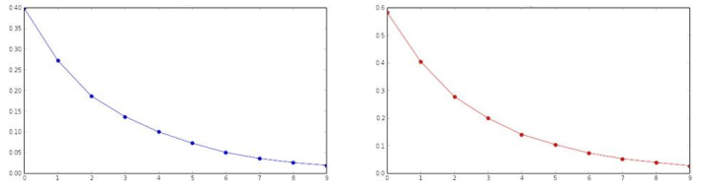
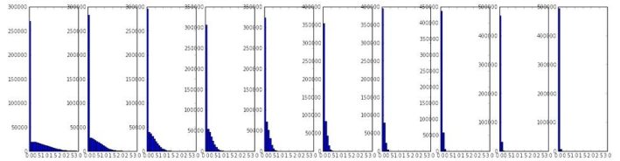
Weight Initialization :
But when using the ReLU
Nonlinearity it breaks.
Layer mean
Layer std
Pooya Mohammadi Lecture 7 - 25 Winter-2020

Slide 26
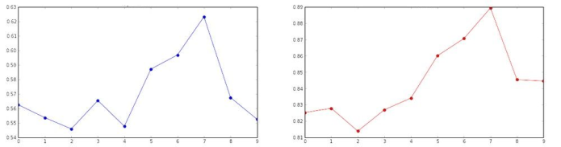
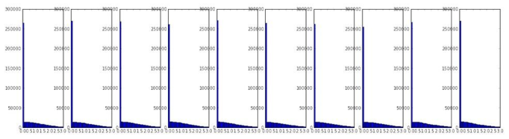
Weight Initialization:
(note additional 2/)
Layer mean
Layer std
[He et al., 2015]
Pooya Mohammadi Lecture 7 - 26 Winter-2020

Slide 27
Batch Normalization
Pooya Mohammadi Lecture 7 - 27 Winter-2020

Slide 28
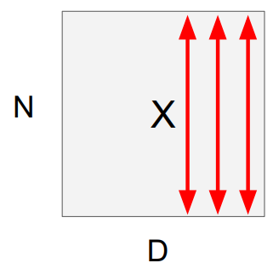
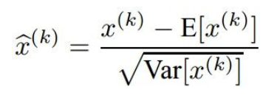
Batch Normalization:
“you want zero-mean unit-variance activations? just make them so.”
1. compute the empirical mean and variance independently for each dimension.
2. Normalize
This is a vanilla differentiable function…
[loffe and Szegedy, 2015]
Pooya Mohammadi Lecture 7 - 28 Winter-2020

Slide 29
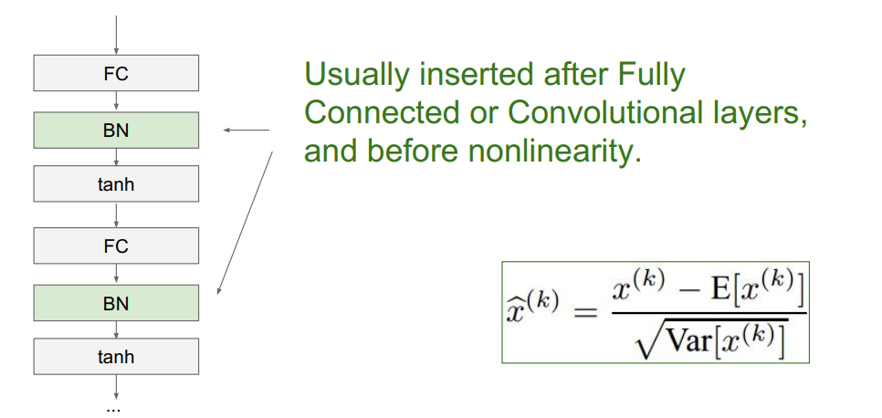
Batch Normalization:
Problem: do we necessarily want a zero-mean unit-variance input?
[loffe and Szegedy, 2015]
Pooya Mohammadi Lecture 7 - 29 Winter-2020

Slide 30
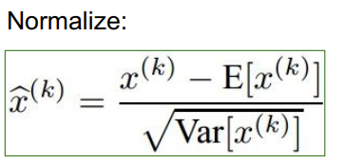
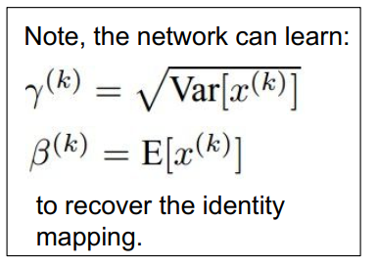
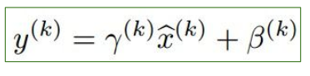
Batch Normalization:
Normalize
And then allow the network to squash the range if it wants to:
[loffe and Szegedy, 2015]
Pooya Mohammadi Lecture 7 - 30 Winter-2020

Slide 31
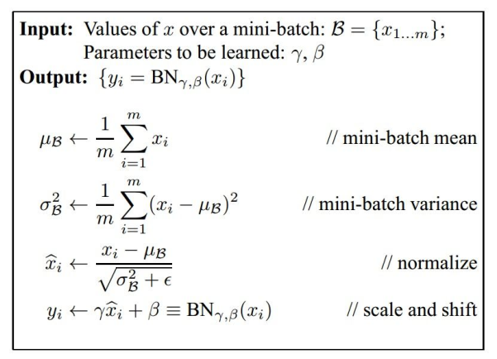
Batch Normalization:
- Improves gradient flow through the network
- Allows higher learning rates
- Reduces the strong dependence on initialization
- Acts as a form of regularization in a funny way, and slightly reduces the need for dropout, maybe
[loffe and Szegedy, 2015]
Pooya Mohammadi Lecture 7 - 31 Winter-2020

Slide 32
Batch Normalization:
Note: at test time BatchNorm layer functions differently:
The mean/std are not computed based on the batch. Instead, a single fixed empirical mean of activations during training is used.
(e.g. can be estimated during training with running averages)
[loffe and Szegedy, 2015]
Pooya Mohammadi Lecture 7 - 32 Winter-2020

Slide 33
Hyper-Parameter Tuning
Pooya Mohammadi Lecture 7 - 33 Winter-2020

Slide 34
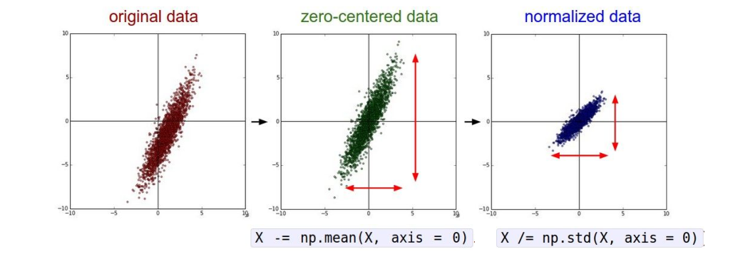
Hyper-Parameter Tuning:
Step 1: Preprocess the data
Pooya Mohammadi Lecture 7 - 34 Winter-2020

Slide 35
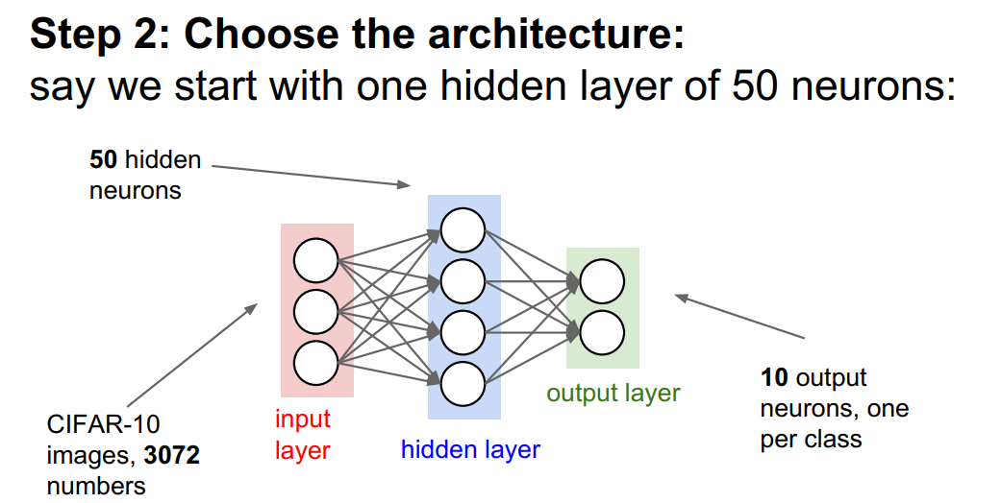
Hyper-Parameter Tuning:
Step 2: Choose the architecture:
say we start with one hidden layer of 50 neurons or LeNet-5 or …
Pooya Mohammadi Lecture 7 - 35 Winter-2020

Slide 36
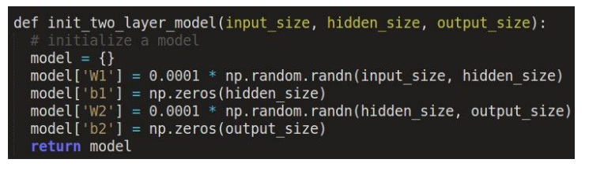
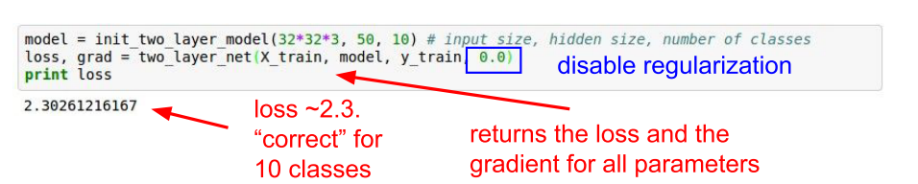
Hyper-Parameter Tuning:
Double check that the loss is reasonable:
Pooya Mohammadi Lecture 7 - 36 Winter-2020

Slide 37

Hyper-Parameter Tuning:
Double check that the loss is reasonable:
Pooya Mohammadi Lecture 7 - 37 Winter-2020

Slide 38

Hyper-Parameter Tuning:
Lets try to train now…
The above code:
take the first 20 examples from CIFAR-10
turn off regularization( reg = 0.0)
use simple vanilla sgd
Tip: Make sure that you can overfit very small portion of the training data
Pooya Mohammadi Lecture 7 - 38 Winter-2020

Slide 39

Hyper-Parameter Tuning:
Lets try to train now…
Tip: Make sure that you can overfit very small portion of the training data
Very small loss,
Train accuracy 1.00, nice!
Pooya Mohammadi Lecture 7 - 39 Winter-2020

Slide 40


Hyper-Parameter Tuning:
Lets try to train now…
Start with small regularization and find learning rate that makes the loss go down.
loss not going down:
learning rate too low
Loss barely changing: learning rate is probably too low
Pooya Mohammadi Lecture 7 - 40 Winter-2020

Slide 41



Hyper-Parameter Tuning:
Lets try to train now…
Start with small regularization and find learning rate that makes the loss go down.
loss not going down:
learning rate too low
loss exploding:
learning rate too high
Pooya Mohammadi Lecture 7 - 41 Winter-2020

Slide 42
Hyper-Parameter Tuning:
Datasets:
t
Train
Valid
Test
Pooya Mohammadi Lecture 7 - 42 Winter-2020

Slide 43
Hyper-Parameter Tuning:
Cross-validation strategy
Coarse -> fine cross-validation in stages
First stage: only a few epochs to get rough idea of what params work
Second stage: longer running time, finer search
… (repeat as necessary)
Tip for detecting explosions in the solver:
if the cost is ever > 3 * original cost, break out early
Pooya Mohammadi Lecture 7 - 43 Winter-2020

Slide 44

Hyper-Parameter Tuning:
For example: run coarse search for 5 epochs
Note it’s best to optimize in log space!!
nice
Pooya Mohammadi Lecture 7 - 44 Winter-2020

Slide 45




Hyper-Parameter Tuning: Fine search
Pooya Mohammadi Lecture 7 - 45 Winter-2020

Slide 46

Hyper-Parameter Tuning: Random Search vs. Grid Search
Random Search for Hyper-Parameter Optimization Bergostra and Bengio, 2012
Pooya Mohammadi Lecture 7 - 46 Winter-2020

Slide 47

Hyper-Parameter Tuning:
network architecture
learning rate, its decay schedule, update type
regularization (L2/Dropout strength)
Pooya Mohammadi Lecture 7 - 47 Winter-2020

Slide 48

Hyper-Parameter Tuning: Monitor loss
Pooya Mohammadi Lecture 7 - 48 Winter-2020

Slide 49

Hyper-Parameter Tuning: Monitor Accuracy
big gap = overfitting
=> increase regularization strength?
no gap
=> increase model capacity?
Pooya Mohammadi Lecture 7 - 49 Winter-2020

Slide 50
Hyper-Parameter Tuning: Summary
Activation Functions (use ReLU)
Data Preprocessing (images: subtract mean)
Weight Initialization (use Xavier/He init)
Batch Normalization (use)
Hyper-Parameter tuning
(random sample hyper-params, in log space when appropriate)
Pooya Mohammadi Lecture 7 - 50 Winter-2020

Slide 51
Let’s Review Again!
Pooya Mohammadi Lecture 7 - 51 Winter-2020

Slide 52




















Last time: AlexNet
MAX-POOL
MAX-POOL
11$×$ 11
s = 4
filters=96
3$×$ 3
s = 2
5$×$ 5
same
filters=256
3$×$ 3
s = 2
55$×$55 $×9$6
27$×$27 $×$96
27$×$27 $×$256
13$×$13 $×$256
227$×$227 $×$3
MAX-POOL
=
3$×$ 3
same
filters=384
3$×$ 3
same
filters=384
3$×$ 3
same
filters=256
3$×$ 3
s = 2
$$⋮$$
$$⋮$$
$$⋮$$
Softmax
1000
13$×$13 $×$384
13$×$13 $×$384
13$×$13 $×$256
6$×$6 $×$256
9216
4096
4096
[Krizhevsky et al., 2012. ImageNet classification with deep convolutional neural networks]
Pooya Mohammadi Lecture 7 - 52 Winter-2020

Slide 53
Last time: AlexNet
Notes:
Similar to LeNet-5 but much bigger >>> 60M parameters
SGD Momentum 0.9
First use of ReLU
Learning rate 1e-2 , reduced by 10 manually when val accuracy plateaus
Used Norm layers(not common anymore)
L2 weight decay 5e-4
Heavy data augmentation
7 CNN ensemble: 18.2% -> 15.4%
Dropout 0.5
[Krizhevsky et al., 2012. ImageNet classification with deep convolutional neural networks]
Pooya Mohammadi Lecture 7 - 53 Winter-2020

Slide 54


















Last time: VGG-16
CONV = 3$×$3 filter, s = 1, same
MAX-POOL = 2$×$2 , s = 2
224$×$224$×$64
112$×$112 $×$64
112$×$112 $×$128
56$×$56 $×$128
[CONV 64]
$×$2
POOL
[CONV 128]
$×$2
POOL
224$×$224 $×$3
56$×$56 $×$256
28$×$28 $×$256
28$×$28 $×$512
14$×$14$×$512
[CONV 256]
$×$3
POOL
[CONV 512]
$$×3$$
POOL
14$×$14 $×$512
7$×$7$×$512
FC
FC
Softmax
[CONV 512]
$×$3
POOL
4096
4096
1000
[Simonyan & Zisserman 2015. Very deep convolutional networks for large-scale image recognition]
Pooya Mohammadi Lecture 7 - 54 Winter-2020

Slide 55

Last time: VGG-16
Notes:
$Simple architecuture$
No Local Response Normalization(LRN)
$n_{h} ,n_{w} decrease by factor of two$
Use VGG16 or VGG19(VGG19 only slightly better, more memory)
$n_{c} increases by factor of two$
Use ensembles for best results
$138M parameters$ :(
FC7 features generalize well to other tasks
$ILSVRC^{′}14 2nd in classification, 1st in localization$
[Simonyan & Zisserman 2015. Very deep convolutional networks for large-scale image recognition]
Pooya Mohammadi Lecture 7 - 55 Winter-2020

Slide 56
ResNet
Pooya Mohammadi Lecture 7 - 56 Winter-2020

Slide 57


ResNet:Question
What happens when we continue stacking deeper layers on a “plain” convolutional neural network?
56-layer model performs worse on both training and test error The deeper model performs worse, but it’s not caused by over-fitting!
Pooya Mohammadi Lecture 7 - 57 Winter-2020

Slide 58
ResNet:
Hypothesis: the problem is an optimization problem, deeper models are harder to optimize
The deeper model should be able to perform at least as well
as the shallower model.
A solution by construction is copying the learned layers from the shallower
model and setting additional layers to identity mapping.
[He et al., 2015. Deep residual networks for image recognition]
Pooya Mohammadi Lecture 7 - 58 Winter-2020

Slide 59


ResNet: Residual block
Solution: Use network layers to fit a residual mapping instead of directly trying to fit a desired underlying mapping
[He et al., 2015. Deep residual networks for image recognition]
Pooya Mohammadi Lecture 7 - 59 Winter-2020

Slide 60
ResNet: Residual block(Notes)
Learning Identity function is easier for Residual Blocks
Identity shortcut(skip) connection add neither extra parameters
nor computational complexity
3. Deep residual networks gains more accuracy from greatly increased depth
[He et al., 2015. Deep residual networks for image recognition]
Pooya Mohammadi Lecture 7 - 60 Winter-2020

Slide 61

ResNet: Architecture
Full ResNet architecture:
- Stack residual blocks
- Every residual block has two 3x3 conv layers
[He et al., 2015. Deep residual networks for image recognition]
Pooya Mohammadi Lecture 7 - 61 Winter-2020

Slide 62
ResNet: Architecture
Full ResNet architecture:
- Stack residual blocks
- Every residual block has two 3x3 conv layers
- Periodically, double # of filters and
downsample spatially using stride 2
(/2 in each dimension)
3x3 conv, 128 filters, /2
spatially with stride 2
3x3 conv, 64 filters
[He et al., 2015. Deep residual networks for image recognition]
Pooya Mohammadi Lecture 7 - 62 Winter-2020

Slide 63
ResNet: Architecture
Full ResNet architecture:
- Stack residual blocks
- Every residual block has two 3x3 conv layers
- Periodically, double # of filters and
downsample spatially using stride 2
(/2 in each dimension)
- Additional conv layer at the beginning
Beginning conv layer
[He et al., 2015. Deep residual networks for image recognition]
Pooya Mohammadi Lecture 7 - 63 Winter-2020

Slide 64
ResNet: Architecture
No FC layers besides FC 1000 to output classes
Global average
pooling layer after last conv layer
Full ResNet architecture:
- Stack residual blocks
- Every residual block has two 3x3 conv layers
- Periodically, double # of filters and
downsample spatially using stride 2
(/2 in each dimension)
- Additional conv layer at the beginning
- No FC layers at the end (only FC 1000 to output classes)
[He et al., 2015. Deep residual networks for image recognition]
Pooya Mohammadi Lecture 7 - 64 Winter-2020

Slide 65

ResNet: Architecture
Total depths of 34, 50, 101, or 152 layers for ImageNet
[He et al., 2015. Deep residual networks for image recognition]
Pooya Mohammadi Lecture 7 - 65 Winter-2020

Slide 66

ResNet: Architecture
1x1 conv, 256 filters projects back to 256 feature maps (28x28x256)
For deeper networks
(ResNet-50+), use “bottleneck” layer to improve efficiency (similar to GoogLeNet)
3x3 conv operates over only 64 feature maps
1x1 conv, 64 filters to project to 28x28x64
[He et al., 2015. Deep residual networks for image recognition]
Pooya Mohammadi Lecture 7 - 66 Winter-2020

Slide 67
ResNet: Training
- Batch Normalization after every CONV layer
- Xavier/2 initialization from He et al.
- SGD + Momentum (0.9)
- Learning rate: 0.1, divided by 10 when validation error plateaus
- Mini-batch size 128
- Weight decay of 1e-5
- No dropout used
[He et al., 2015. Deep residual networks for image recognition]
Pooya Mohammadi Lecture 7 - 67 Winter-2020

Slide 68

ResNet: Training:
Experimental Results:
- Able to train very deep networks without degrading (152 layers on ImageNet, 1202 on Cifar)
- Deeper networks now achieve low training error as expected
- Swept 1st place in all ILSVRC and COCO 2015 competitions
ILSVRC 2015 classification winner (3.6% top 5 error) -- better than “human performance”!
[He et al., 2015. Deep residual networks for image recognition]
Pooya Mohammadi Lecture 7 - 68 Winter-2020

Slide 69
Questions??
Pooya Mohammadi Lecture 7 - 69 Winter-2020

